Slide 1
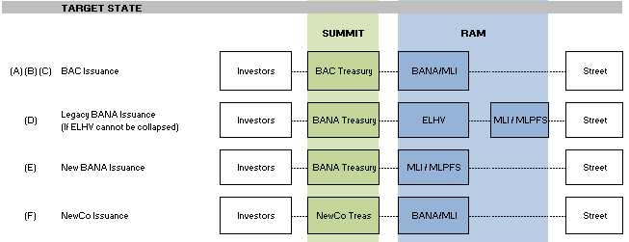
Case Study: BAC Structured Notes
Changing Support Models – BAC/ML merger moves the Equity Linked Notes (ELN) business to a Treasury-based Support Model
Notes issuance booked in Summit (Treasury v. investors) with hedges booked in multiple Global Markets systems (Vmaster, eBlotter, Vienna, Orca, Sierra, and Altair)
Global Markets (i.e. GELP) trade bookings in RAM (Street-facing and Treasury-facing legs)
Difficult to get a centralized view of risk and PnL for the SN business
Monticello Consulting Services
Entity build-out plans & requirements
Project Management
Testing Governance for complex change initiatives
Trade Migrations Expertise
Go-live planning
SN Front Office Booking Systems
Rates
VMaster
Advantage R/W
Credit
eBlotter
Vienna
FX
Sierra
Altair
ORCA
Musketeer
Treasury
Summit
Key Monticello Differentiators
Monticello has long-standing relationships with Treasury and GBAM change managers, having partnered on complex change programs in 2010 through 2013
Monticello is currently engaged with Corporate Investments and International Treasury to implement Regulatory Reform initiatives, including real-time reporting of Treasury’s OTC swaps
Demonstrated Effectiveness
Monticello supported the migration of legacy BAC ELNs from Hawks to Ram & Summit in 2011
Monticello has engaged in entity build-out projects for BAML including:
BANA for ELP (BAC/ML Transition)
BANA (ELHV, NMSS, NMS Cayman)

